Slide 1
T Lymphocyte & Rheumatic diseases
A.R.Rajaei MD
arrajaei@gmail.com
Rheumatology Department
Loghman hospital

Slide 2
Introduction
T lymphocytes are critical to the pathogenesis of systemic rheumatic diseases.
Understanding of the roles of T cells in disease has been enriched by the description of highly distinct effector subsets of CD4 T lymphocytes. The purpose of this review is to describe selected advances in the biology of T lymphocytes that are pertinent to the pathogenesis or treatment of rheumatic diseases.
Imbalances in the numbers and functions of specific T cell subsets are key pathogenic derangements in systemic rheumatic diseases, and these insights are leading to changes in clinical practice.

Slide 3
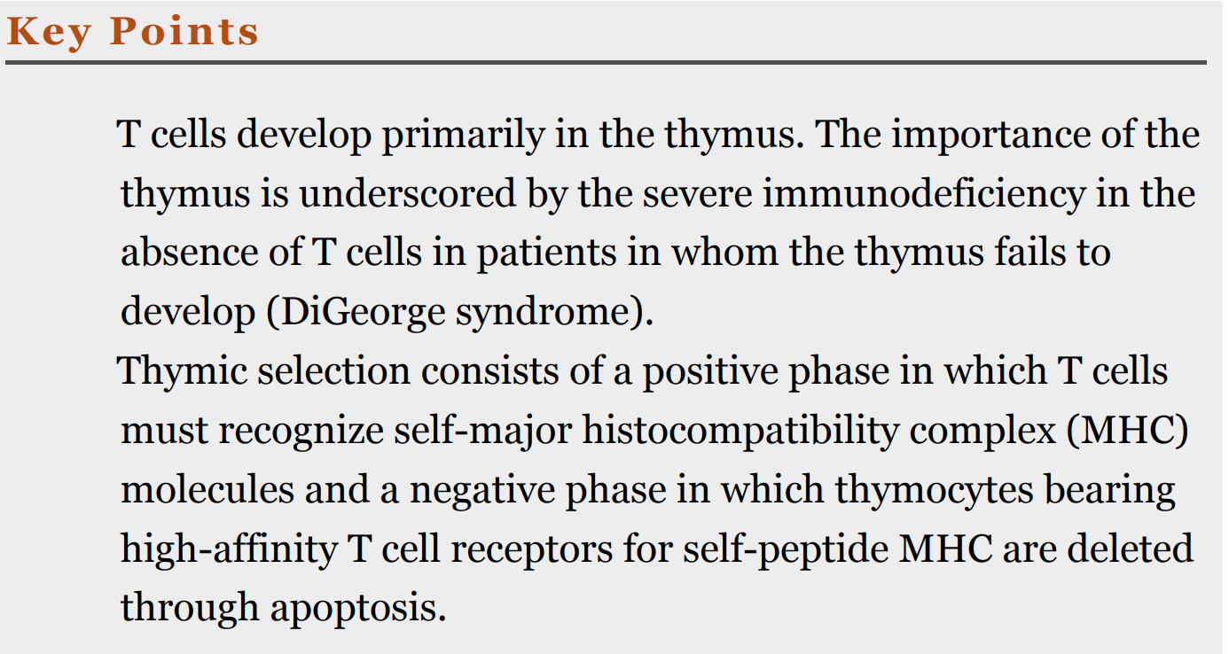

Slide 4
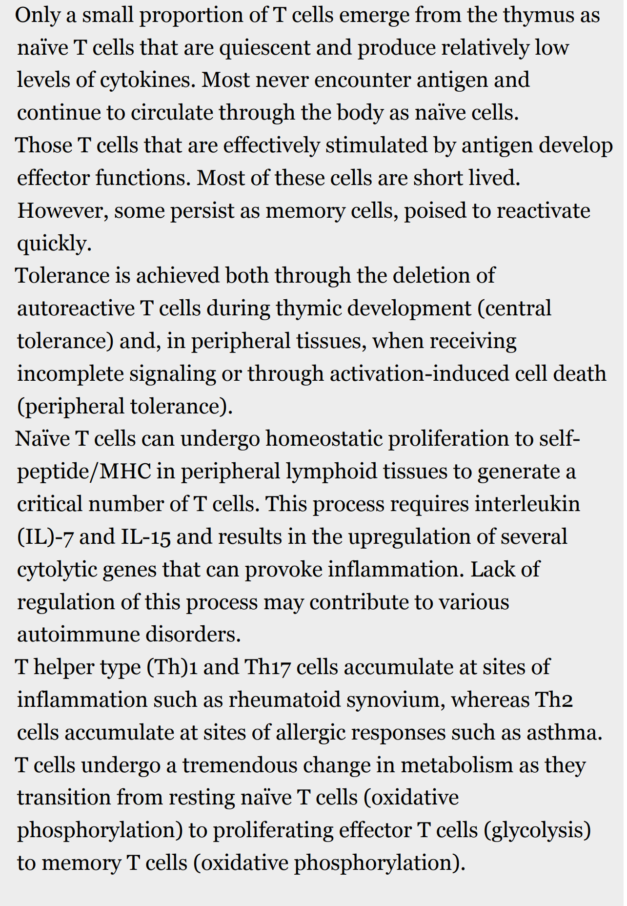

Slide 5
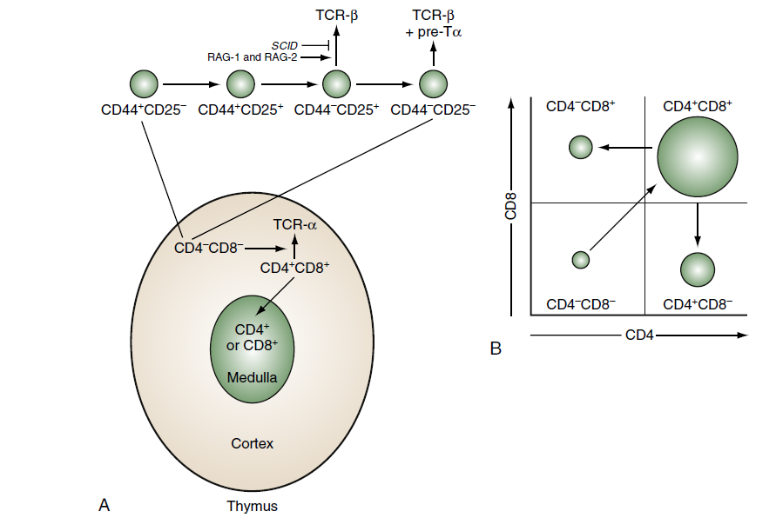
Sequence of thymocyte development.
(A) The earliest thymocyte precursors lack

Slide 7
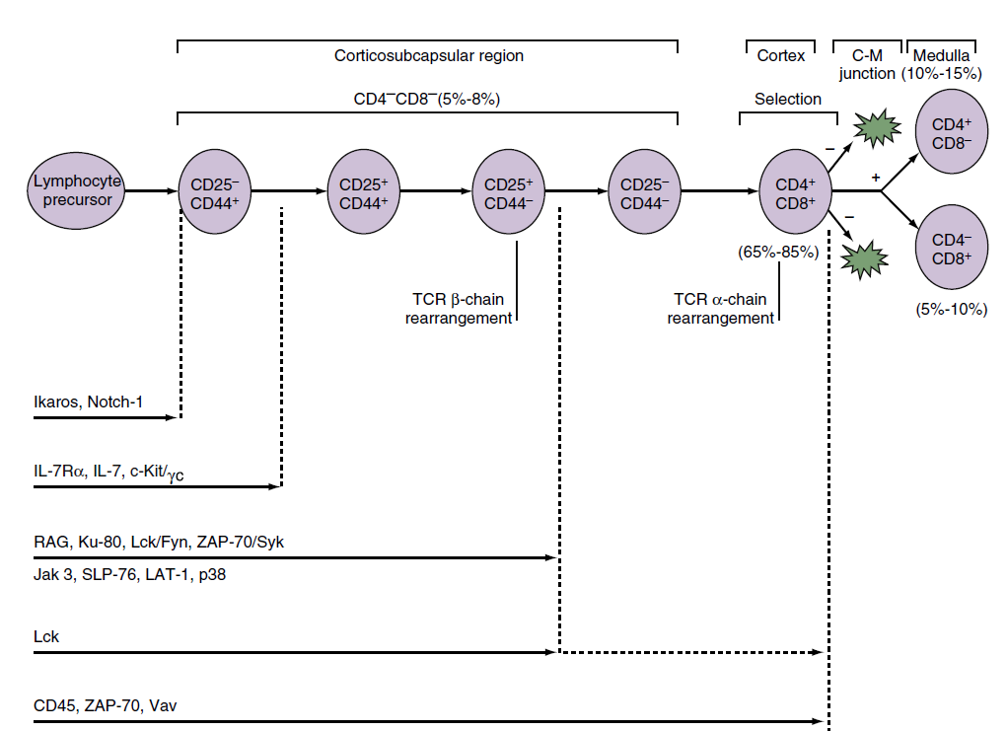

Slide 9
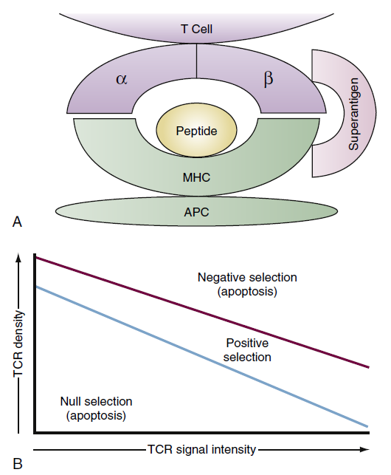

Slide 10
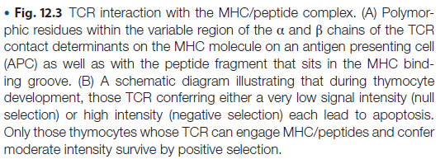

Slide 11
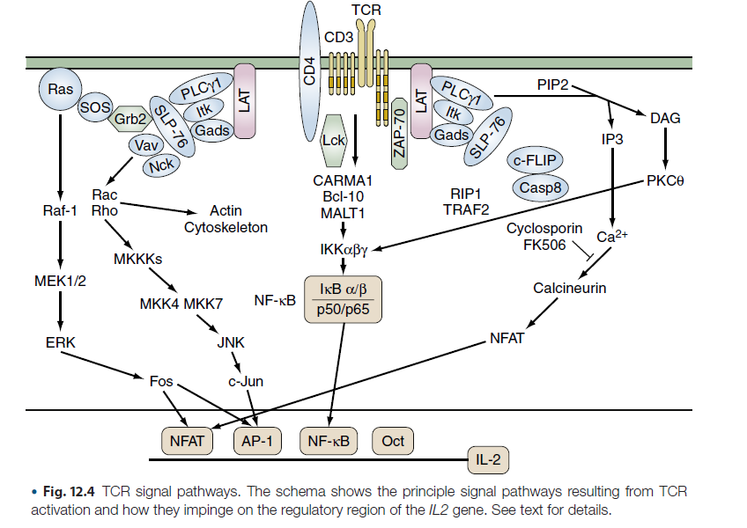

Slide 12
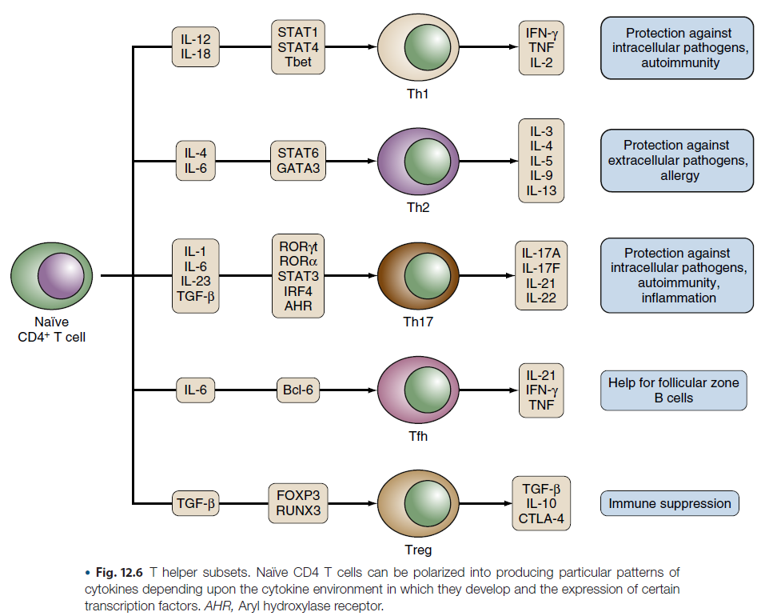

Slide 13
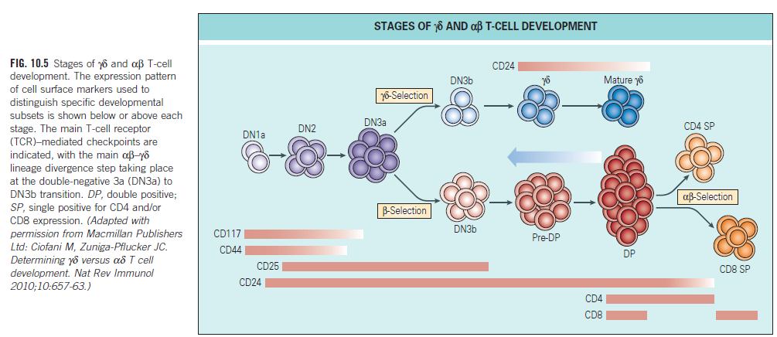

Slide 14
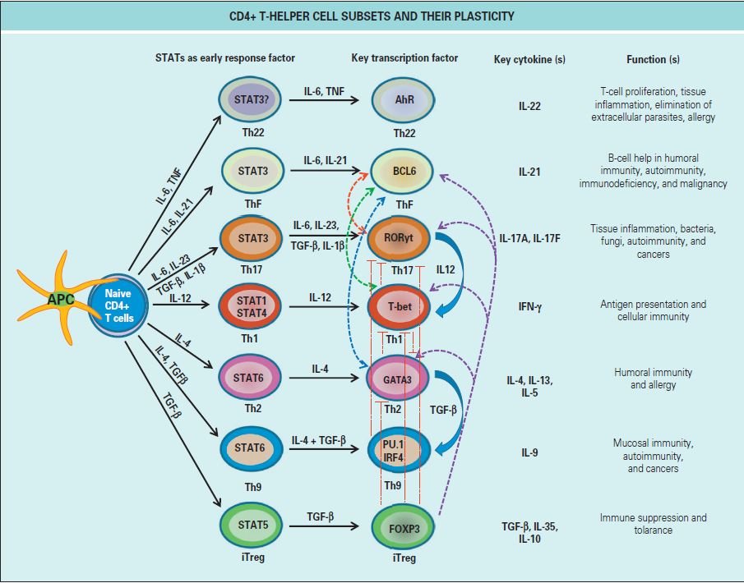

Slide 16
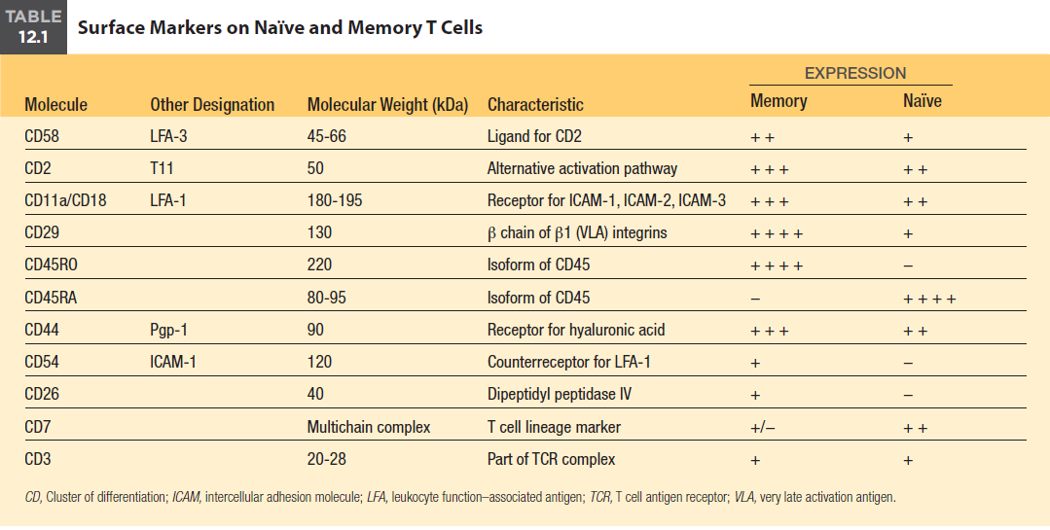

Slide 17
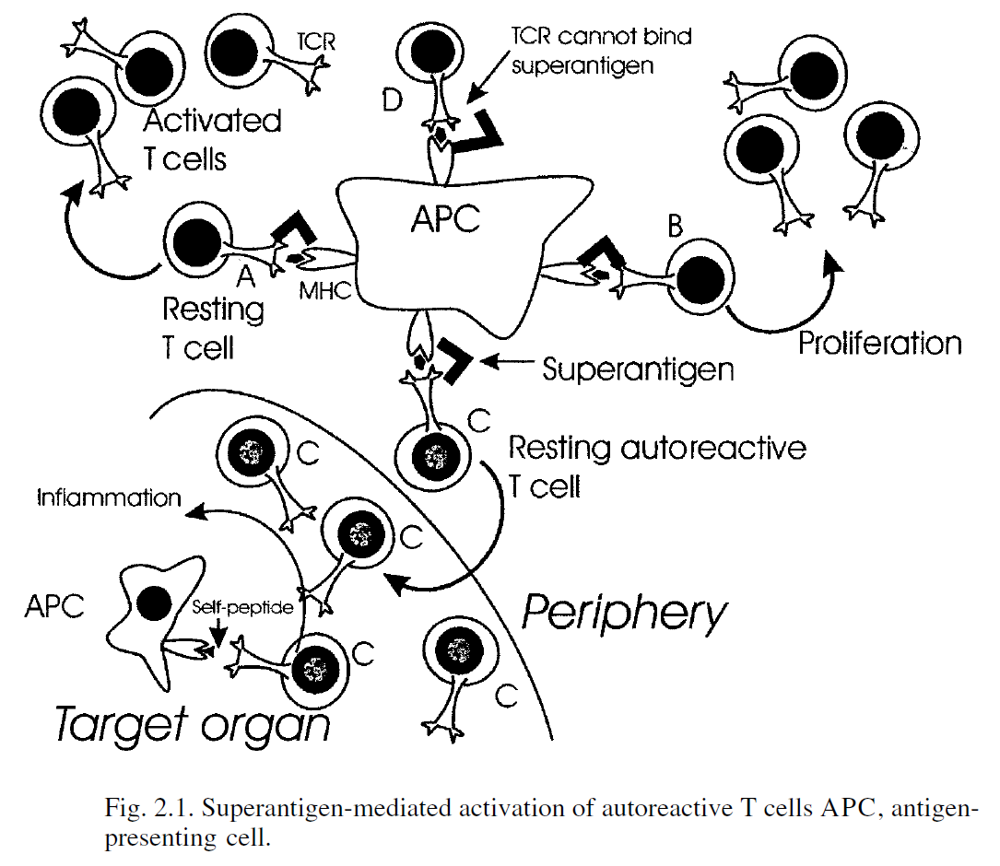

Slide 18
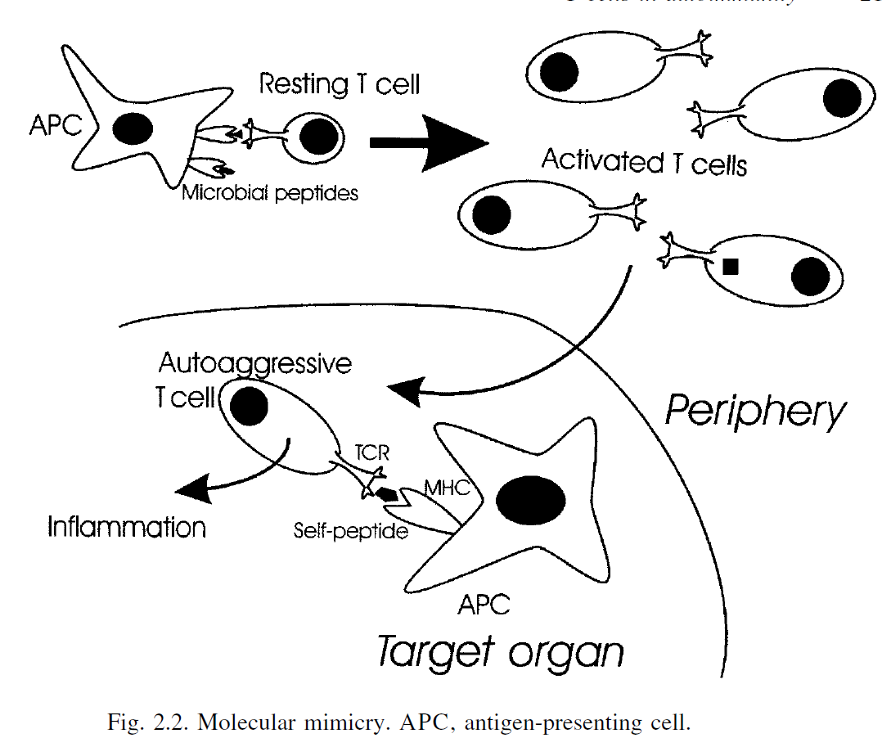

Slide 19
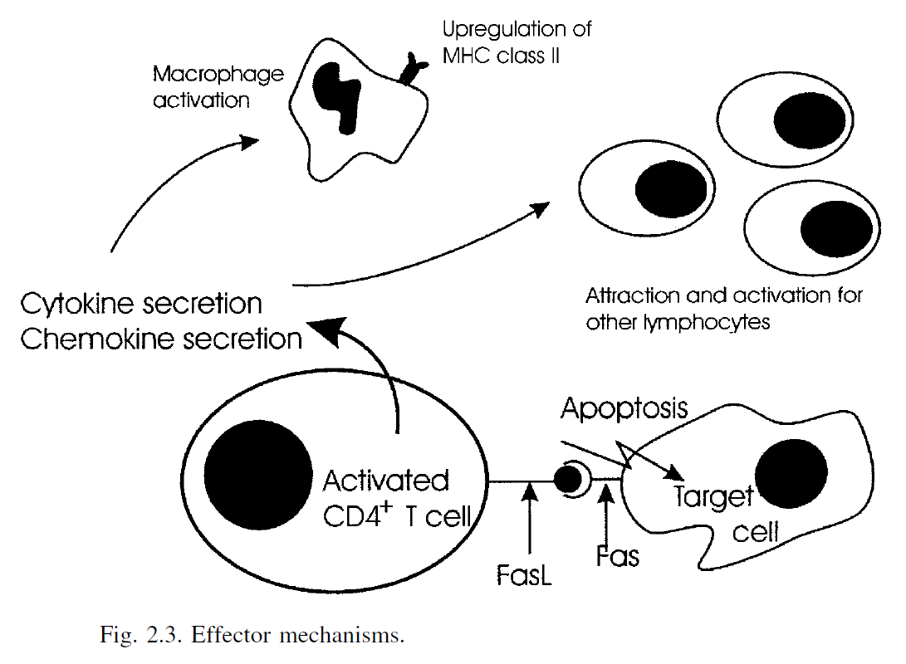

Slide 20
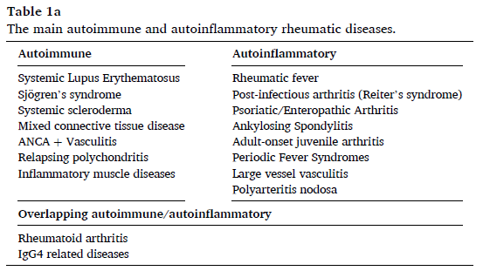

Slide 21
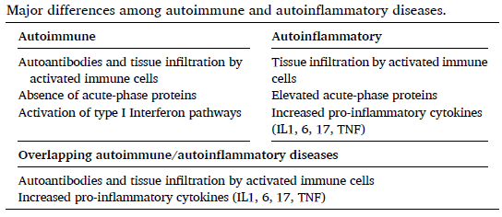

Slide 23
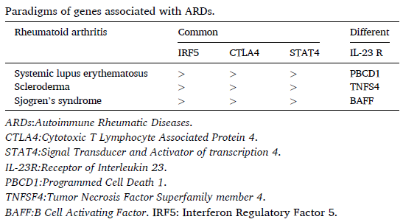

Slide 24
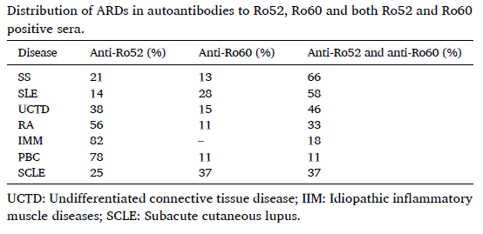

Slide 25
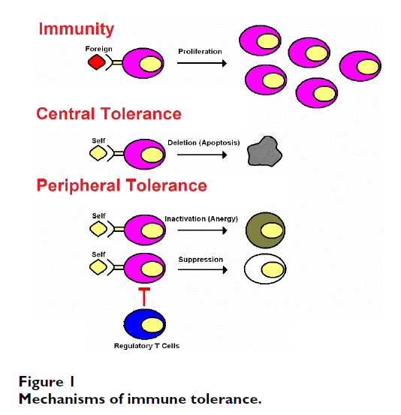

Slide 26
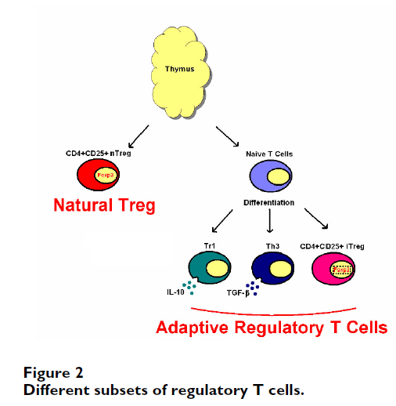

Slide 27
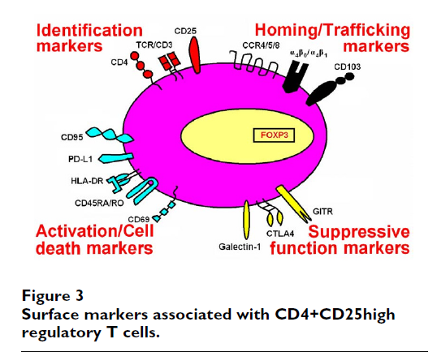

Slide 28
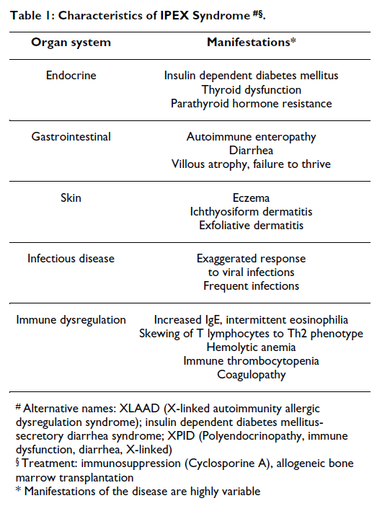

Slide 30
Conclusion
T cells develop primarily in the thymus. The importance of the thymus is underscored by the absence of T cells in patients in whom the thymus has failed to develop (e.g., DiGeorge syndrome).
Thymic selection consists of a positive phase in which T cells must recognize self-major histocompatibility complex (MHC) molecules and a negative phase in which thymocytes bearing high-affinity T cell receptors for self-peptide MHC are deleted through apoptosis.
Only a small proportion of T cells emerge from the thymus as naïve T cells that are quiescent and produce relatively low levels of cytokines. After they acquire memory phenotype (CD45RO+), they can produce high levels of cytokines.
Naïve T cells can undergo homeostatic proliferation to self-peptide/ MHC in peripheral lymphoid tissues to generate a critical number of T cells. This process requires IL-7 and IL-15 and results in the upregulation of several cytolytic genes that can provoke inflammation. Lack of regulation of this process may contribute to various autoimmune disorders.
Th1 and Th17 cells accumulate at sites of inflammation such as rheumatoid synovium, whereas Th2 cells accumulate at sites of allergic responses such as asthma.
T cells undergo a tremendous change in metabolism as they transition from resting naïve T cells (oxidative phosphorylation) to proliferating effector T cells (glycolysis) to memory T cells (oxidative phosphorylation).

